Slide 1
BRITISH AIRWAYS VIRTUAL INTERNSHIP – TASK 2 _______________________
Predicting customer buying behaviour

Slide 2
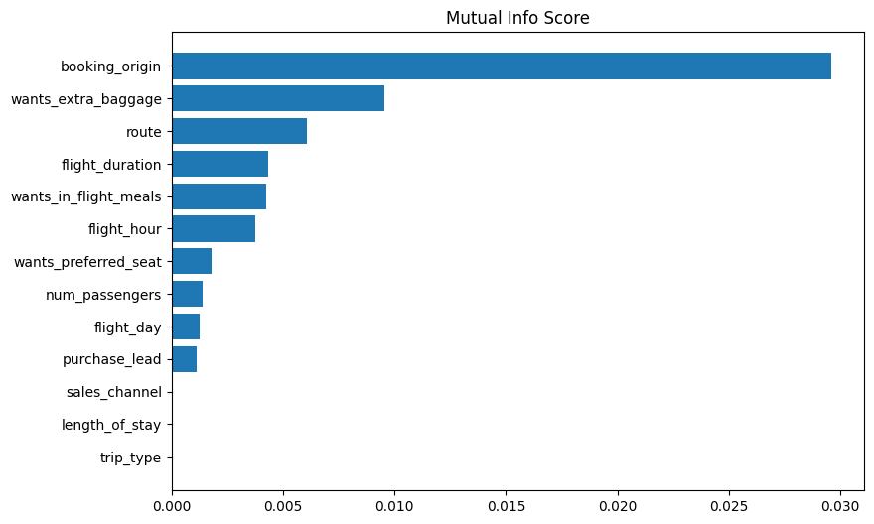
Model Used – Random Forest
AUC Score – 0.55
Accuracy – 82.97%
Features used :
booking_origin,
wants_extra_baggage,
route, flight_duration,
wants_in_flight_meals,
flight_hour MI_SCORE

